Slide 1
Pre-Processor directives and Conditional compilation directives and Macros

Slide 2
DEFINITION
In C programming language, the preprocessors are the programs that process the source code before the compilation. We can say that preprocessors are not the part of the program compilation, it's a separate process which process the code before the compilation..

Slide 3
Preprocessor Directives
Preprocessor Directives | Description
#define | To define a preprocessor macro.
#include | To include the code from another file or to include header file in the current code.
#undef | To undefine a defined preprocessor macro.
#ifdef | To check whether a macro is defined or not, it returns true if macro is defined.
#ifndef | To check whether a macro is defined or not, it returns true if macro is not defined.
#if, #else, #elif, #endif | To control the compilation of portions of a source code.
#error | To print the error message on stderr.
#pragma | To issue special commands to the compiler, using a standardized method.

Slide 4
#if preprocessor directive
The #if is a preprocessor directive in C programming language and it is used for conditional compilation.
General syntax for of the #if directive is:
#if conditional_expression
statements;
#endif
if conditional_expression is true, the code written between #if and #endif i.e. the statements will be executed.

Slide 5
Program to demonstrate #if preprocessor directive
#include <stdio.h>
#define MAX_GF 100
int main(){
printf("Hello\n");
#if MAX_GF>=50
printf("\n");
printf("Code for more than 50 GFs\n");
#endif
printf("Bye!\n");
return 0;
}

Slide 6
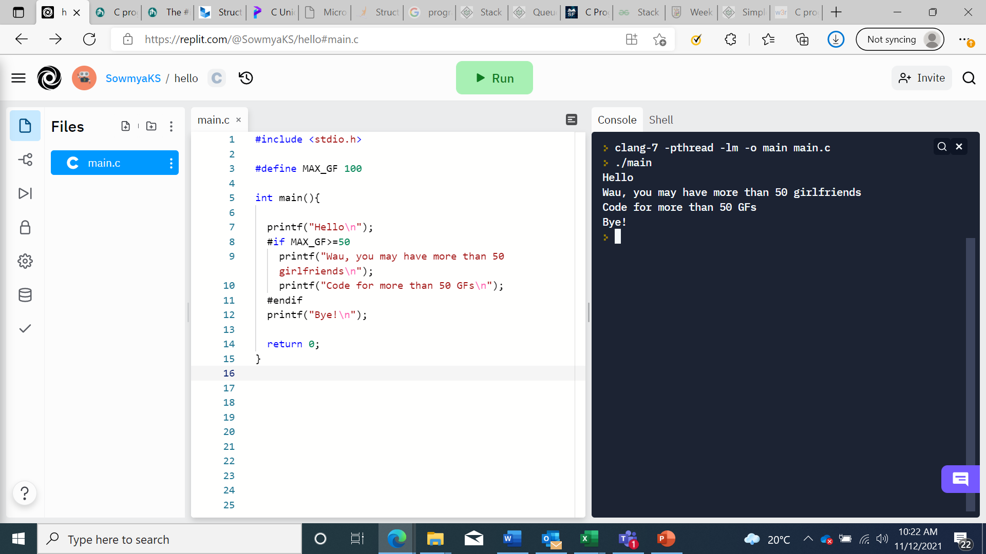
Output

Slide 7
#if ... #else directive
The #if ... #else is a preprocessor directive in C programming language and it is used for conditional compilation, where one of the code section needs to be compiled based on the condition from two given code sections.
General for of the #if ... #else directive is:
#if conditional_expression
statements-true;
#else
statements-false;
#endif
If conditional_expression is true, the code written between in #if block i.e. statements-true will be executed and if conditional_expression is false, code written in #else block i.e. statements-false will be executed.

Slide 8
#if ... #else directive
#include <stdio.h>
#define MAX_GF 20
int main(){
printf("Hello\n");
#if MAX_GF>=50
printf("Wau, you may have more than 50 girlfriends\n");
printf("Code for more than 50 GFs\n");
#else
printf("Wau, you may not have more than 50 girlfriends\n");
printf("Code for less than 50 GFs\n");
#endif
printf("Bye!\n");
return 0;
}

Slide 9
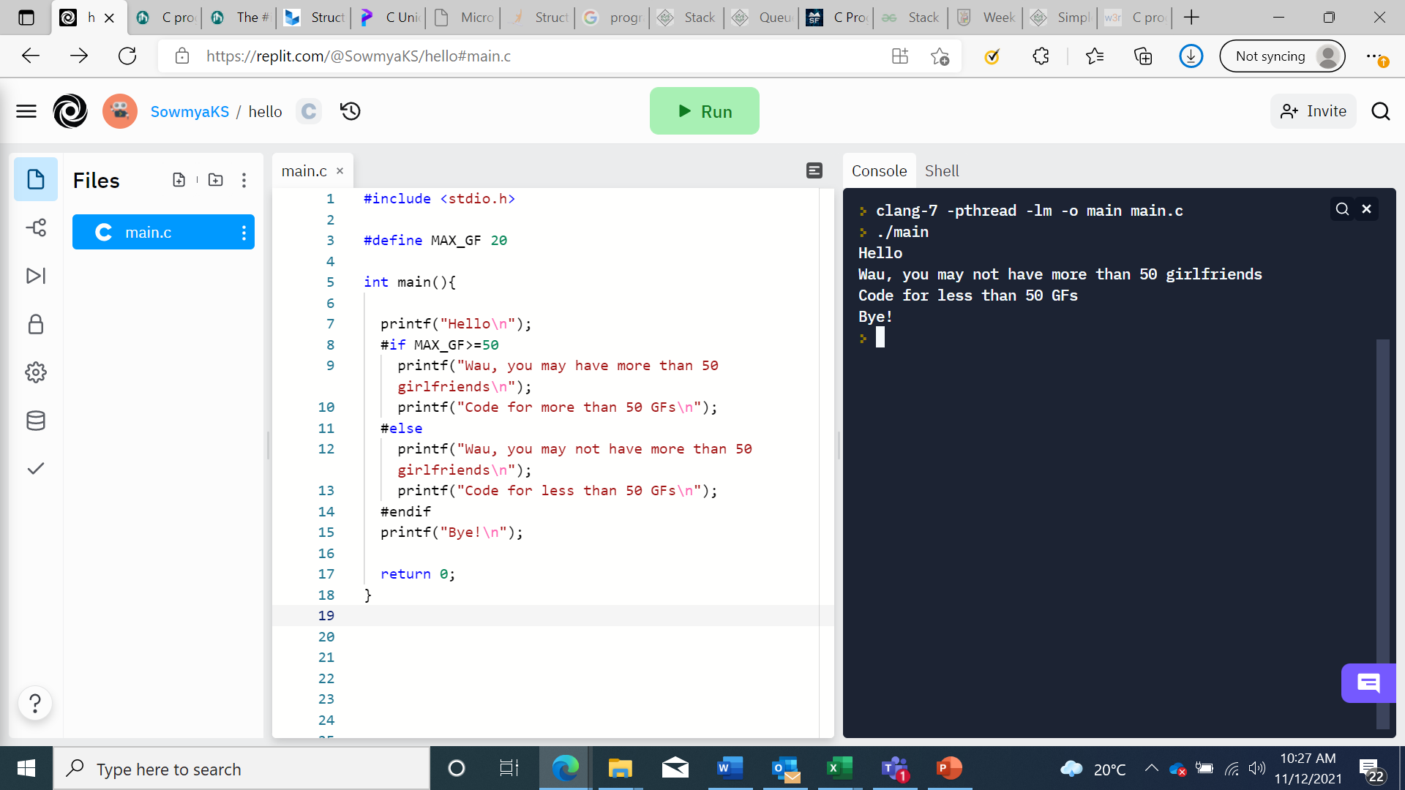
Output

Slide 10
#line directive
The #line is a preprocessor directive in C programming language; it is used to reset the line number in the code. We can reset line number from any line in the code.

Slide 11
#line directive
#include <stdio.h> /*line 1*/
/*line 2*/
int main(){ /*line 3*/
/*line 4*/
printf("Hello world\n");
/*line 5*/
//print current line /*line 6*/
printf("Line: %d\n",__LINE__); /*line 7*/
//reset the line number by 36 /*line 8*/
#line 36 /*reseting*/
//print current line
/*line 36*/
printf("Line: %d\n",__LINE__); /*line 37*/
printf("Bye bye!!!\n"); /*line 39*/
/*line 40*/
return 0; /*line 41*/
} /*line 42*/

Slide 12
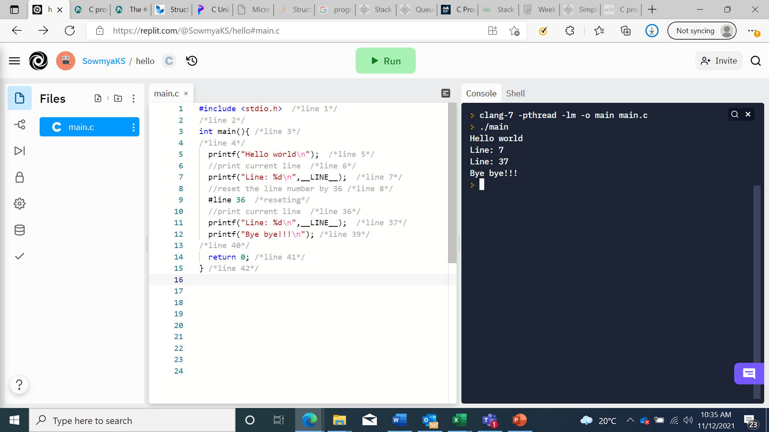
Output

Slide 13
__LINE__ Macro
The __LINE__ is an inbuilt Macro in C programming language, it returns current line number of the code.
#include <stdio.h>
int main(){
printf("Hello world\n");
printf("Line: %d\n",__LINE__);
printf("How are you?\n");
printf("Line: %d\n",__LINE__);
printf("Bye bye!!!\n");
return 0;
}

Slide 14

Output

Slide 15
Macro: __func__
__func__ is the predefine macro, and it is used to get the name of the current function. This macro is added in C99.
#include <stdio.h>
//fun1
void fun1(void){
printf("Called function is: %s\n",__func__);
}
//fun2
void fun2(void){
printf("Called function is: %s\n",__func__);
}
//Main code
int main(){
printf("Called function is: %s\n",__func__);
//function callings
printf("Now,calling the functions...\n");
fun1();
fun2();
return 0;
}

Slide 16
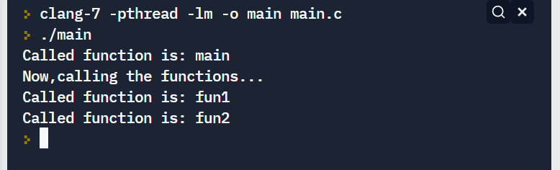
Output

Slide 17
Define Macros for YES and NO constants using #define in C
#include <stdio.h>
#define YES 1
#define NO 0
//function to check and return YES or NO
//for EVEN or ODD
int checkEvenODD(int num)
{
if( num%2 == 0 )
return YES;
else
return NO;
}
//Main code
int main(){
int n;
n = 10;
if( checkEvenODD(n) == YES )
printf("%d is an EVEN number\n",n);
else
printf("%d is an ODD number\n",n);
n = 11;
if( checkEvenODD(n) == YES )
printf("%d is an EVEN number\n",n);
else
printf("%d is an ODD number\n",n);
return 0;
}

Slide 18

Output

Slide 19
Define a function like Macro that should use printf in C
#include <stdio.h>
#define SUM(a,b) (printf("SUM of %d and %d is = %d\n", a, b, a+b))
//Main code
int main(){
//adding 10 and 20
SUM(10,20);
//adfing 100 and 200
SUM(100,200);
return 0;
}

Slide 20

Output

Slide 21
Define Macro PRINT to print given integer argument in C
#include <stdio.h>
#define PRINT(val) (printf("value is: %d\n",val))
//Main code
int main(){
PRINT(10);
PRINT(100);
PRINT(-12);
PRINT(0);
return 0;
}

Slide 22

Output

Slide 23
Define Macros to SET and CLEAR bit of a PIN in C
#include <stdio.h>
#define SET(PIN,N) (PIN |= (1<<N))
#define CLR(PIN,N) (PIN &= ~(1<<N))
int main(){
unsigned char val = 0x11;
unsigned char bit = 2;
printf("val = %X\n",val);
//set bit 2 of val
SET(val,bit);
printf("Aftre setting bit %d, val = %X\n", bit, val);
//clear bit 2 of val
CLR(val,bit);
printf("Aftre clearing bit %d, val = %X\n", bit, val);
return 0;
}

Slide 24

Output

Slide 25
Define Macro to toggle a bit of a PIN in C
#include <stdio.h>
#define TOGGLE(PIN,N) (PIN ^= (1<<N))
int main(){
unsigned char val = 0x11;
unsigned char bit = 2;
printf("val = %X\n",val);
//TOGGLE bit number 2
TOGGLE(val, bit);
printf("Aftre toggle bit %d first time, val = %X\n", bit, val);
//TOGGLE bit number 2 again
TOGGLE(val, bit);
printf("Aftre toggle bit %d second time, val = %X\n", bit, val);
return 0;
}

Slide 26
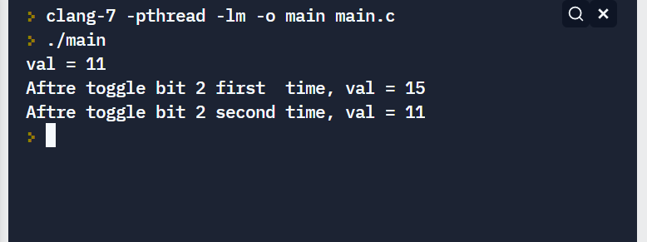
Output

Slide 27
Define a Macro to set Nth bit to Zero in C
#include <stdio.h>
#define SETPIN(PIN,N) (PIN &= ~(1<<N))
int main(){
unsigned char val = 0xFF;
unsigned char bit = 2;
printf("val = %X\n",val);
//SET bit number 2 to zero
SETPIN(val,bit);
printf("Aftre setting bit %d to zero, val = %X\n", bit, val);
return 0;
}

Slide 28
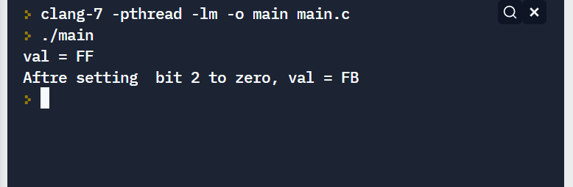
Output

Slide 29
Print argument (i.e. variable name, value) using Macro in C
To print argument (which is passed as Macro argument), we use # operator in C programming language.
# prints the passed argument as it is, it may be a variable name, value etc.
#include <stdio.h>
#define SQUARE(N) printf("Square of " #N " is = %d\n",(N*N))
#define CUBE(N) printf("Cube of " #N " is = %d\n",(N*N*N))
int main()
{
int number = 10;
//passing variable name
SQUARE(number);
CUBE(number);
//passing values
SQUARE(10);
CUBE(10);
return 0;
}

Slide 30

Output

Slide 31
Print error message from any function with function name, line number in C
#include <stdio.h>
float devide(int a, int b)
{
float result;
if(b!=0){
result = (float)a/(float)b;
}
else{
result=0;
printf("Error at line %d in function \"%s\"\n",((__LINE__)-3),__func__);
//ERROR at 3 lines above: ((__LINE__)-3)
}
return result;
}
int main()
{
printf("%f\n",devide(10,3));
printf("%f\n",devide(10,0));
return 0;
}

Slide 32

Output

Slide 33
Define a Macro to find total number of elements in C
#include <stdio.h>
#define ARRAY_LEN(ARRAY_NAME, TYPE)(sizeof(ARRAY_NAME)/sizeof(TYPE))
int main()
{
int iArr[10];
float fArr[5];
char cArr[50];
printf("Total elements in iArr: %d\n", ARRAY_LEN(iArr, int));
printf("Total elements in fArr: %d\n", ARRAY_LEN(fArr, float));
printf("Total elements in cArr: %d\n", ARRAY_LEN(cArr, char));
return 0;
}

Slide 34
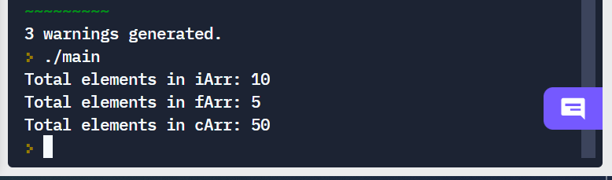
Output

